Slide 1

Rockbuster stealth
Data Analyst

Slide 2

Background
Rockbuster Stealth LLC is a movie rental company that used to have stores around the world. Facing stiff competition from streaming services such as Netflix and Amazon Prime, the Rockbuster Stealth management team is planning to use its existing movie licenses to launch an online video rental service in order to stay competitive.
Objective
Need to help the Rockbuster Stealth’s business intelligence (BI) department in launching strategy for the new online video service.

Slide 3
Movie Overview
46 Minutes
Min Movie Length
185 Minutes
Max Movie Length
$9.99
Min Replace Cost
$29.99
Max Replace Cost
3 Days
Minimum Rental Duration
7 Days
Maximum Rental Duration
$0.99
Min Rental Rate
$4.99
Max Rental Rate
3 Days

Slide 4
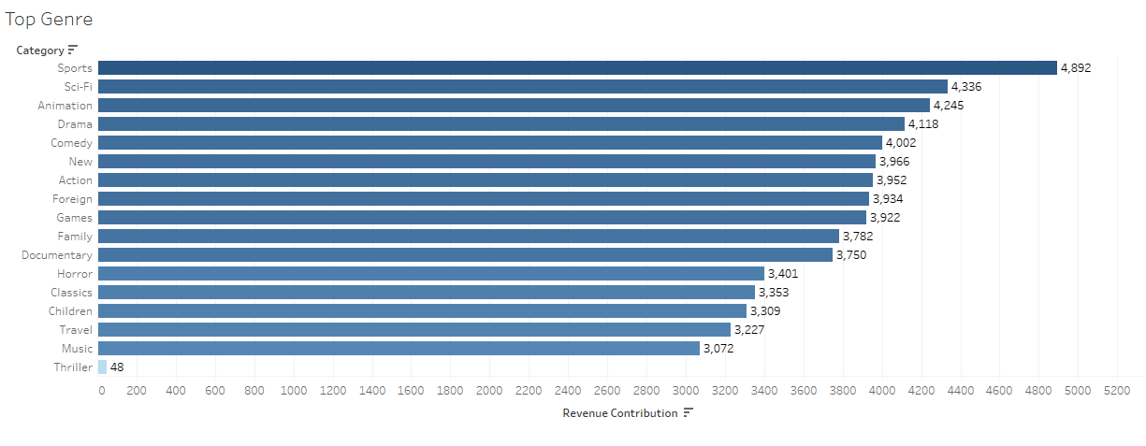
Revenue By Genre :
There are 17 different movie genres.
The most popular genres are Sports, Sci-fi and Animation.
The lowest is Thriller.

Slide 5
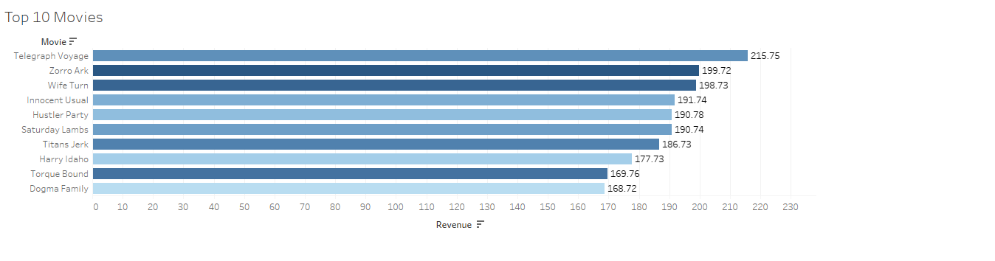
Revenue By Movie : This Graph Depicts the amount of revenue received based on the top 10 movies. The Movie Telegraph Voyage seemed to have contributed to most of the revenue with $215.75.

Slide 6

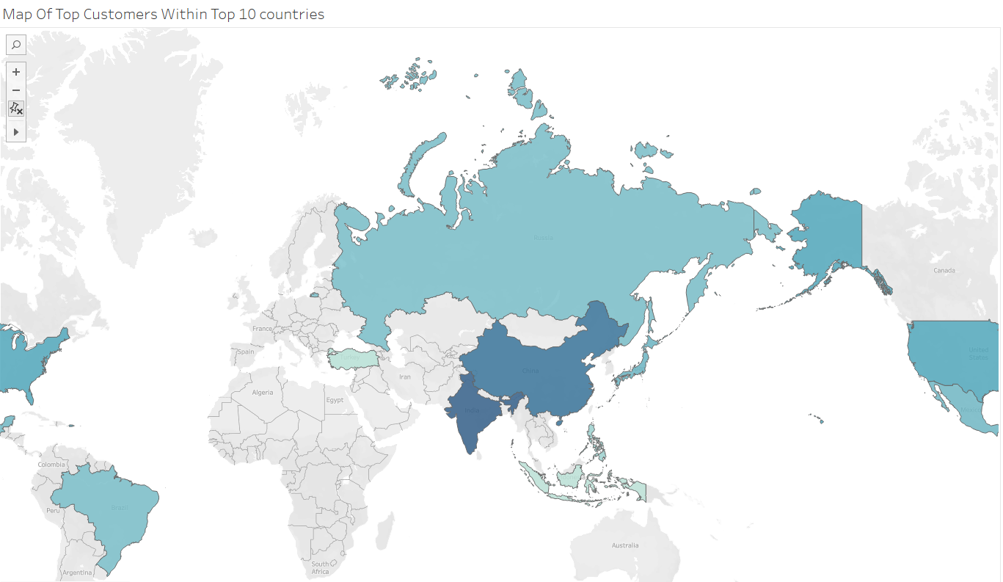
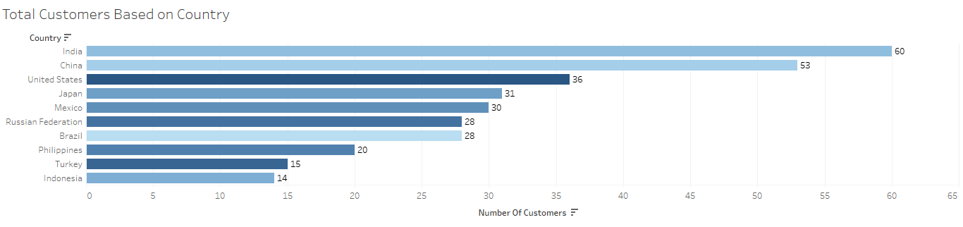
Top Customers By Country : This graph represents the top 10 countries with the most customers. The top 5 countries are India, China, United States, JAPAN AND MEXICO.

Slide 7
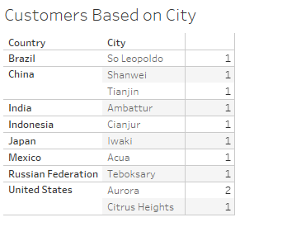
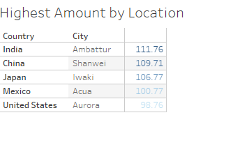
These Graphs show the cities that have the highest number of customers as well as the number of customers who paid the most amount of money to Rock buster.

Slide 8

Summary
The top 3 popular genres are Sports, Sci-Fi and Animation, while the least popular genre is Thriller.
The countries with the highest customer count are India, China, United Sates, Japan and Mexico. Within these countries the cities to focus on are
India- Ambattur
China- Shanwei, Tianjin
United States- Aurora, Citrus Heights-US
Japan- Iwaki
Mexico- Acua

Slide 9
Recommendations
Creating movies that are similar to those that have a high revenue.
Focus on marketing in genres that have a high revenue like Sports

Slide 10

Thank you

